Slide 1



Healthcare fraud detection
Suhita acharya

Slide 2


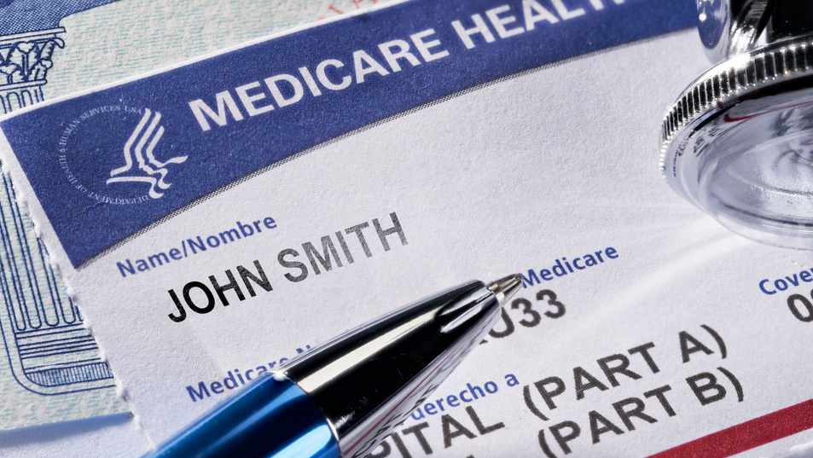
What is Medicare fraud?
Medicare Frauds are committed by Doctors/Hospitals aided by medical malpractices.
Medical Providers try to maximize reimbursement received from Insurance companies via illegitimate activities such as submitting false claims:
How do they commit fraud?
Billing for care that they never rendered.
Submitting duplicate claims.
Falsifying claim/patient info.
Disguising non-covered services as covered services.
Using incorrect diagnosis/procedure codes.

Slide 3

Common Types of Health Care Fraud:
Double Billing
Phantom Billing
Upcoding
Unbundling
Kickbacks
Unnecessary Services
False price reporting

Slide 4
Medicare claims dataset
Beneficiary:
Info about patients for whom claims have been submitted
Inpatient:
Claim level data (with provider/doctor info) for the patients that have stayed at the hospital for the medical service.
Outpatient:
Claim level data (with provider/doctor info) for the patients that have stayed at the hospital for the medical service.
Inpatient
Outpatient
Beneficiary

Slide 5
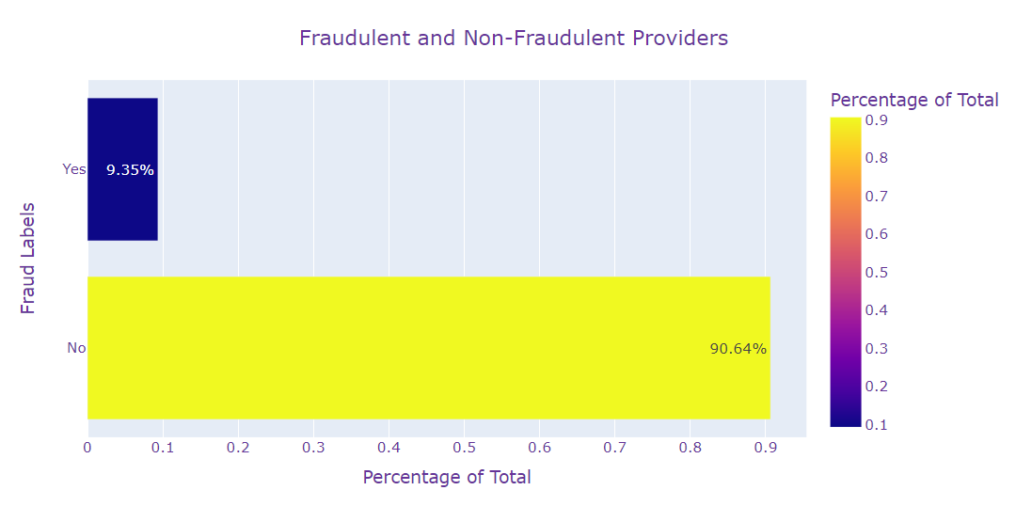
Fraud labels
Fraud labels provided for Hospitals.
Fraud/Non-Fraud providers:
Imbalanced dataset, imbalance handled via SMOTE.
SMOTE and BorderlineSMOTE up sampling technique employed before modeling.

Slide 6
DATA PREPROCESSING
Data was robust-scaled:
Due to the inclusion of outliers
Two different sets were evaluated for each model:
One using SMOTE and one using Borderline SMOTE upsampling
Different model types attempted:
Logistic Regression
Random Forest
Linear SVC
ADABoost
XGBoost
LightGBM
Hyperparameters were tuned based on the F1 metric. Final parameters are chosen by Recursive Feature Selection
Missing Data Imputed:
Beneficiary:
Inpatient:
Outpatient:
Label Encoding: All categorical features
New Feature Creation:
Deceased, Tot_Reimbursed_Amt, Hospital_Stay, Claim_Duration, Physician_Count, Claim_Count, Chr_Cond_Count, etc.
Dropped features:
With high null values, ones from which other features were created, etc.
Combined all datasets with fraud labels.

Slide 7
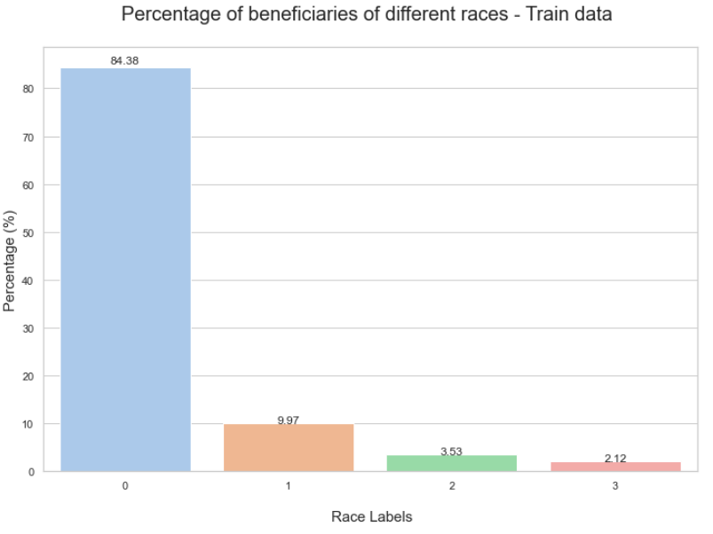
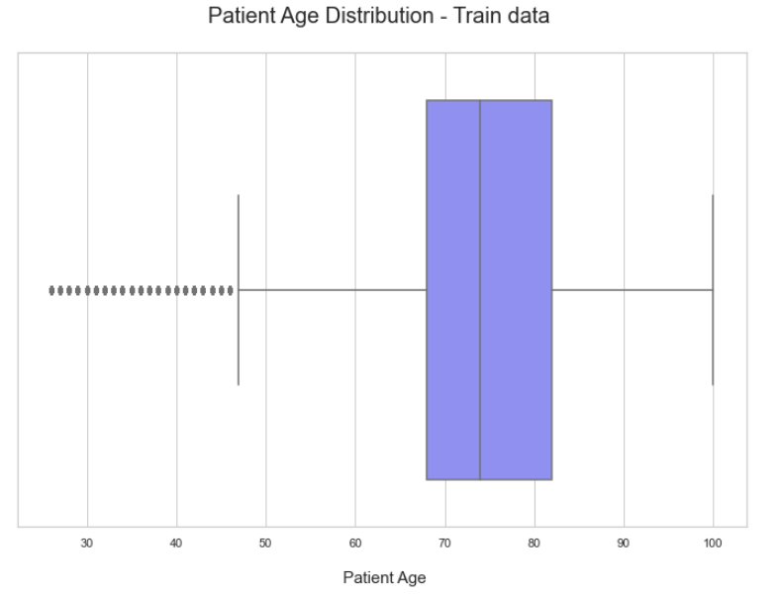
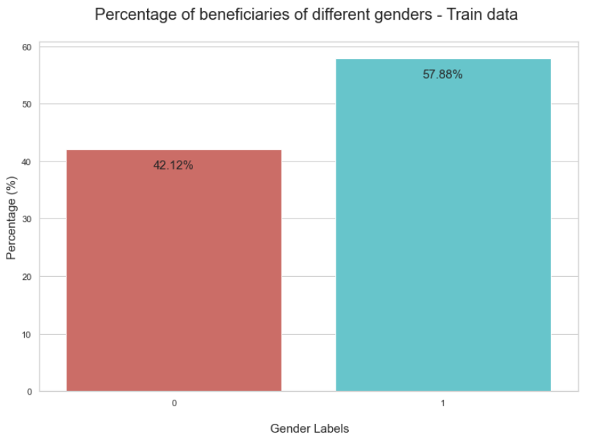
Before we proceed…
Basic Patient Information:
Most of the Beneficiaries that have Inpatient/Outpatient claims are alive.

Slide 8
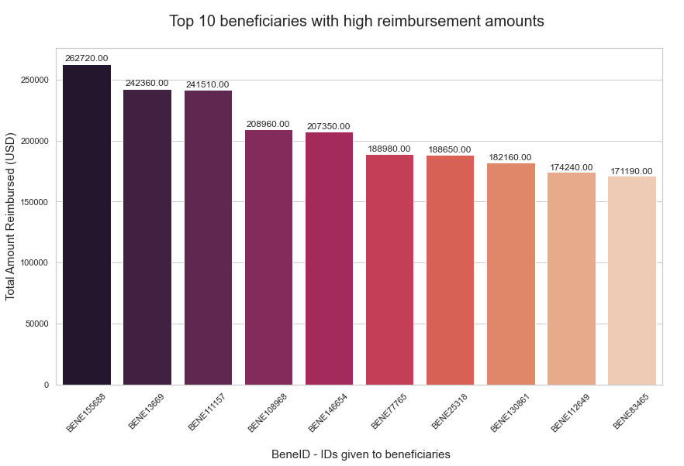
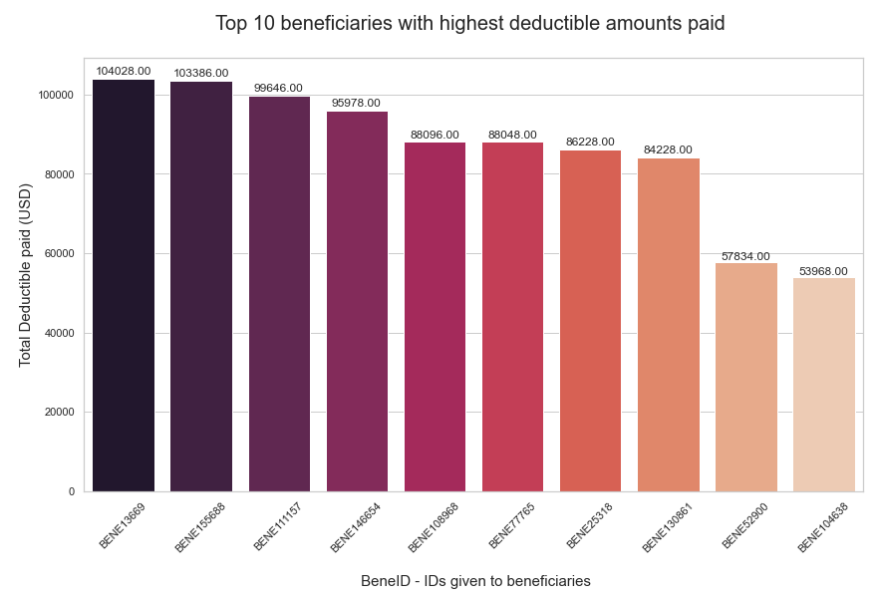
PATIENT INFORMATION (CONT..)

Slide 9
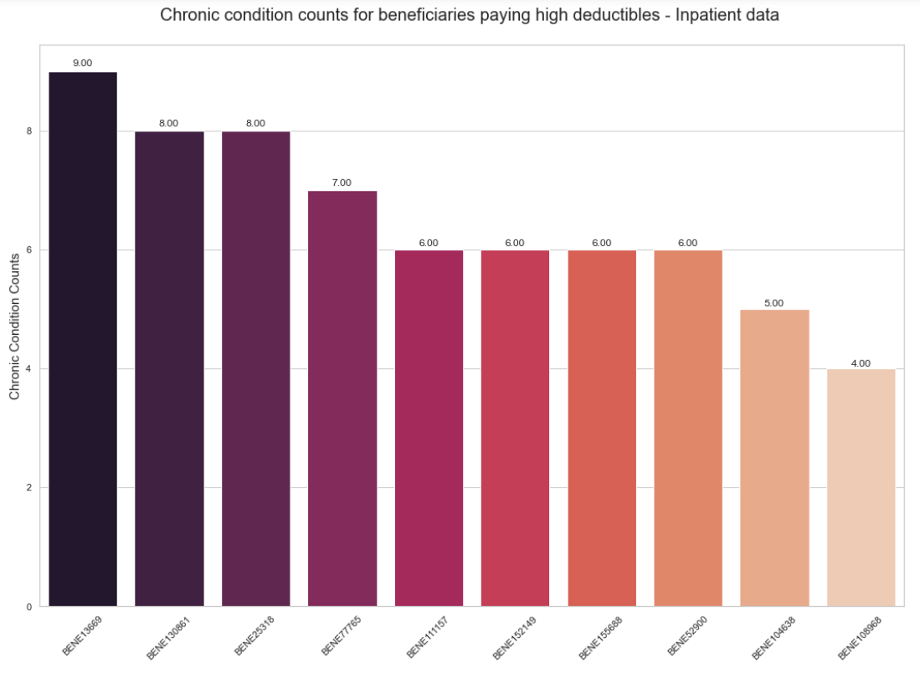
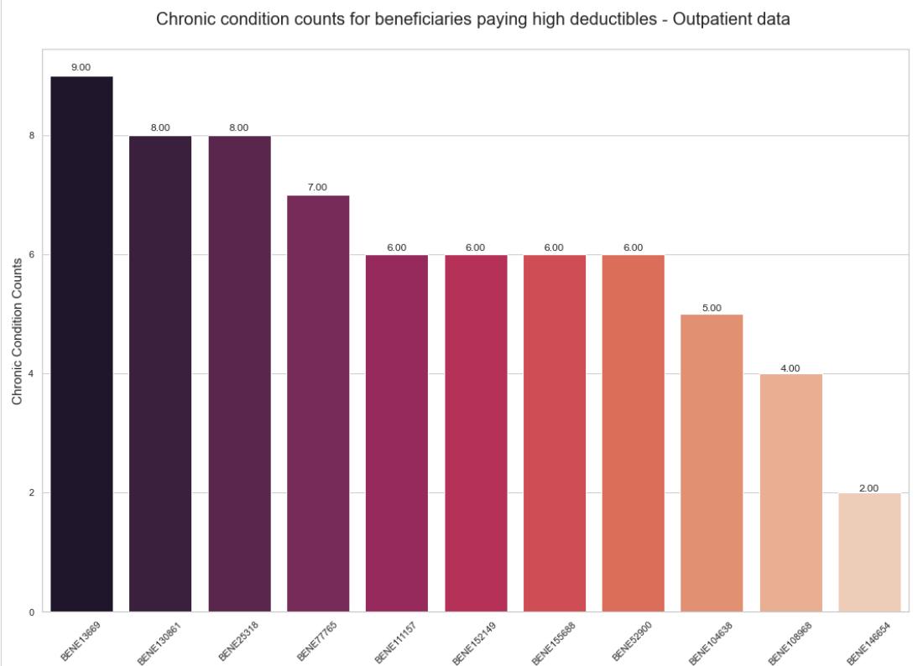
PATIENT INFORMATION (CONT..)
Notes:
Think of adding the high deduc reimburse graphs

Slide 10
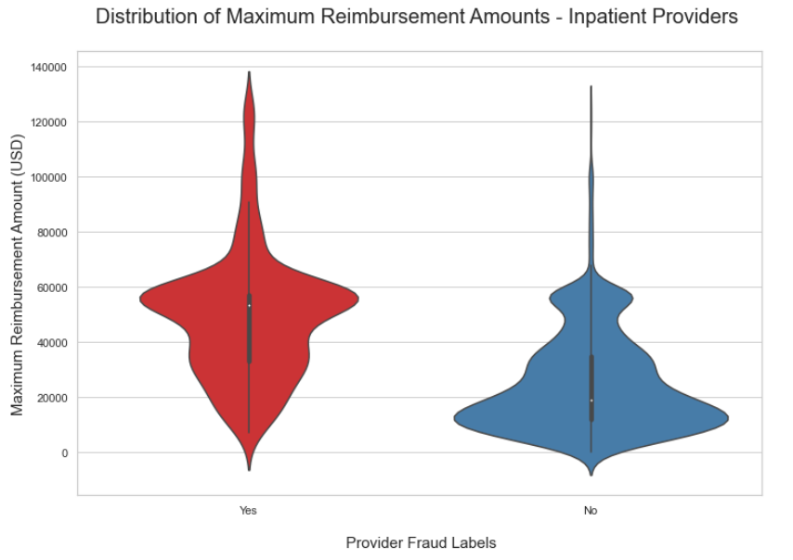
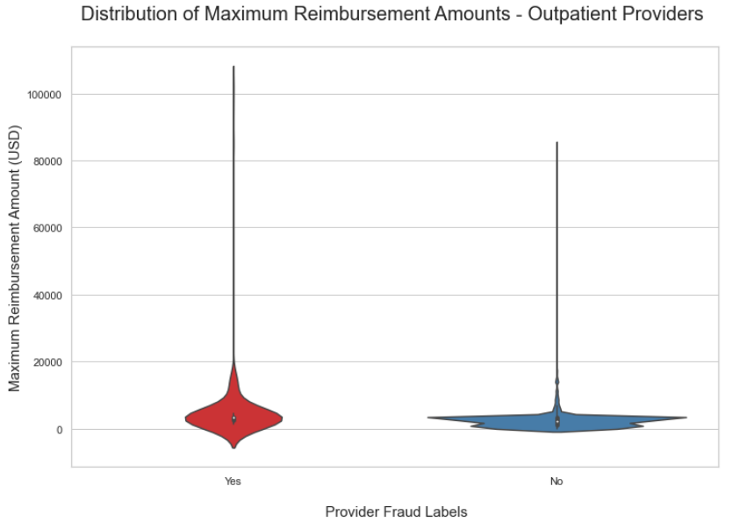
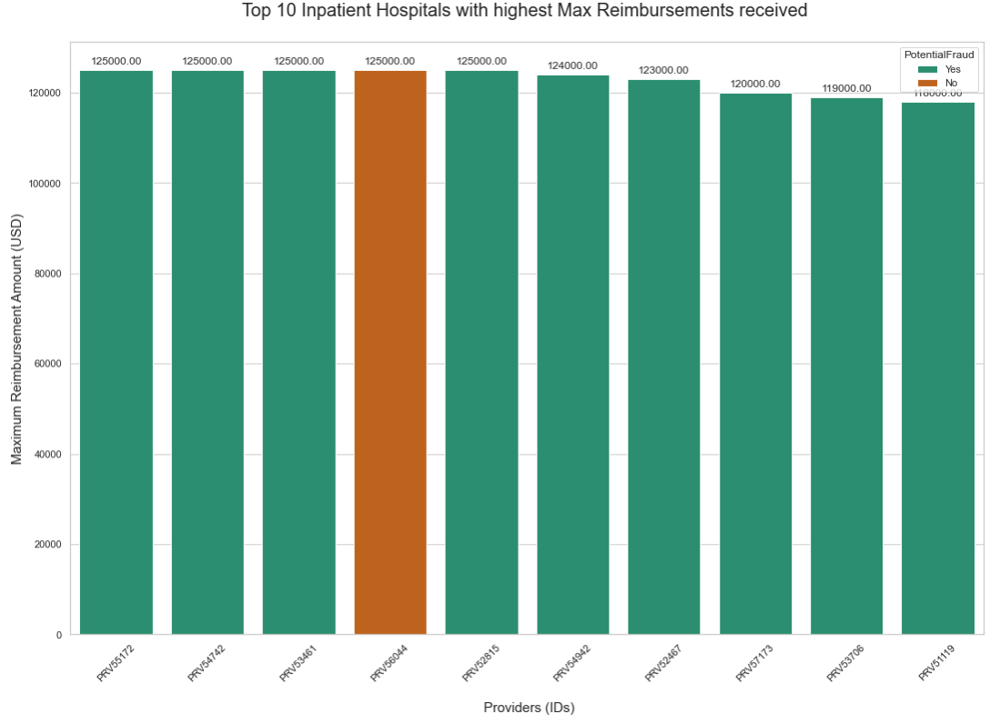
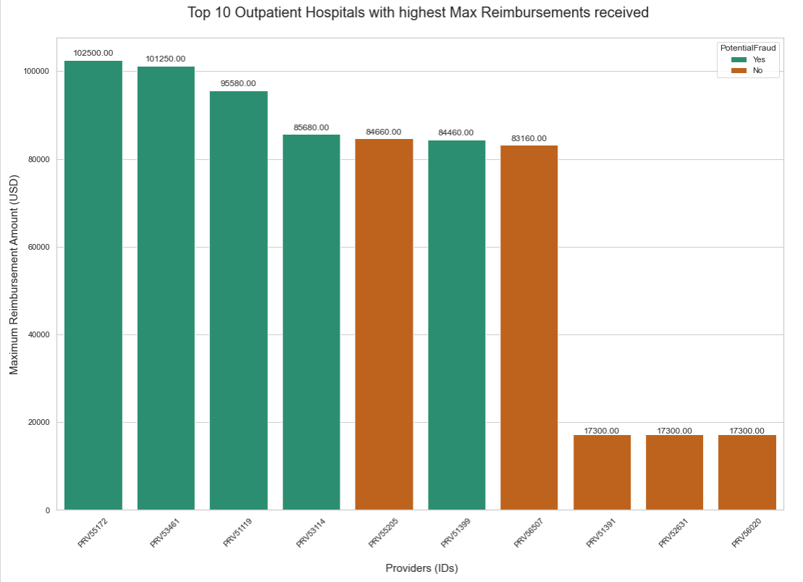
Fraud vs non-fraud provider study:

Slide 11
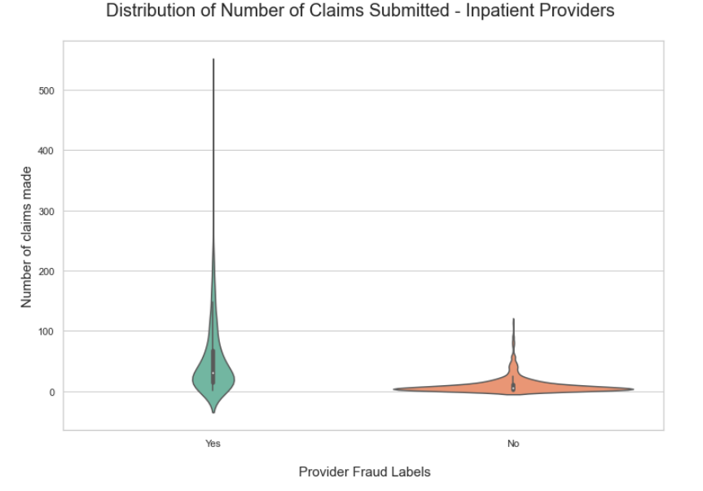
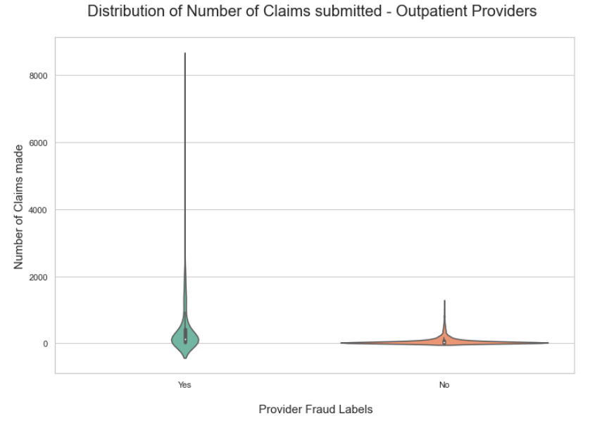
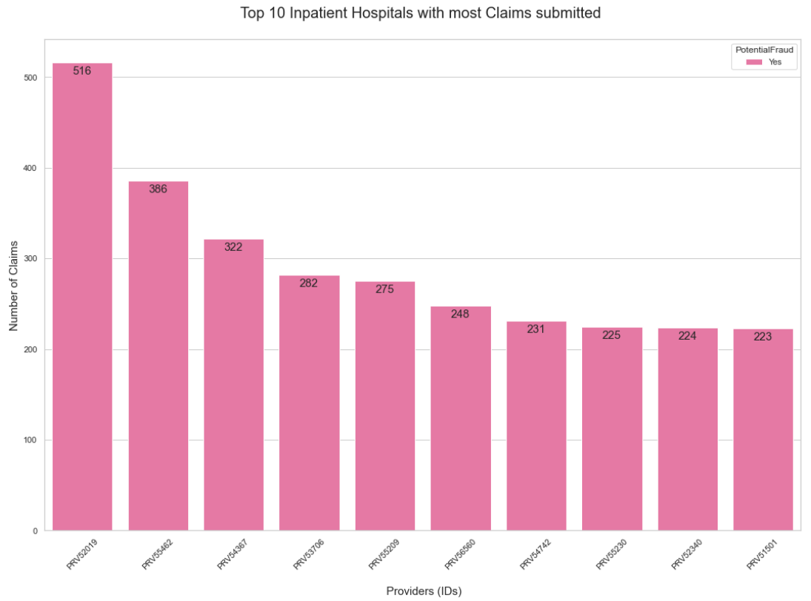
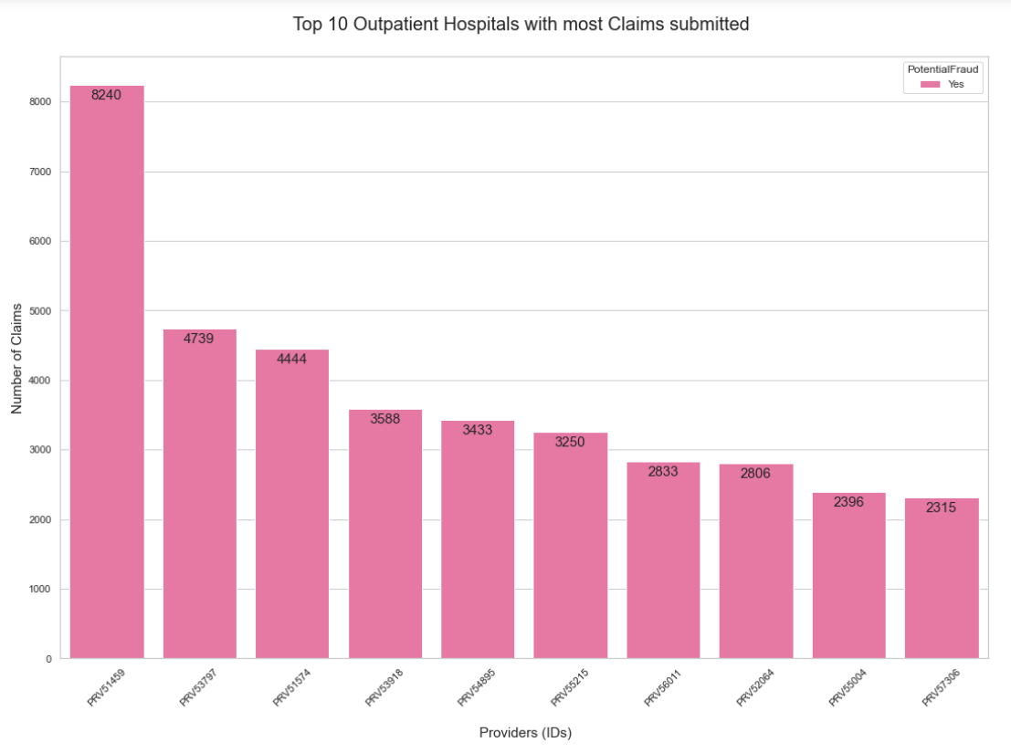
Fraud vs non-fraud provider study:

Slide 12
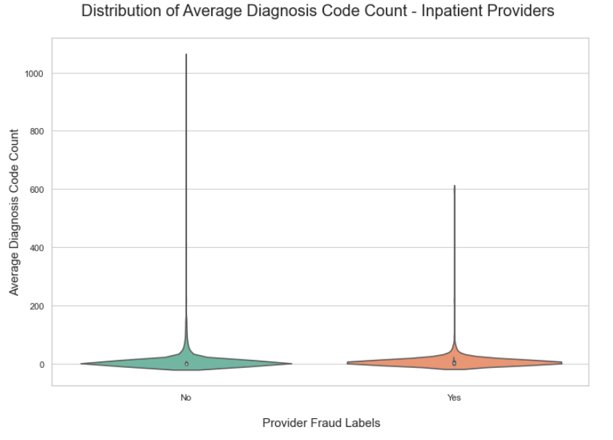
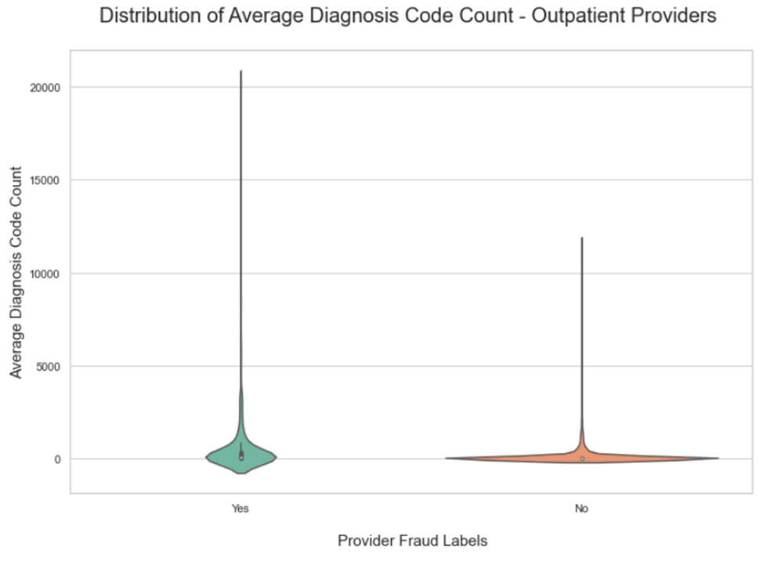
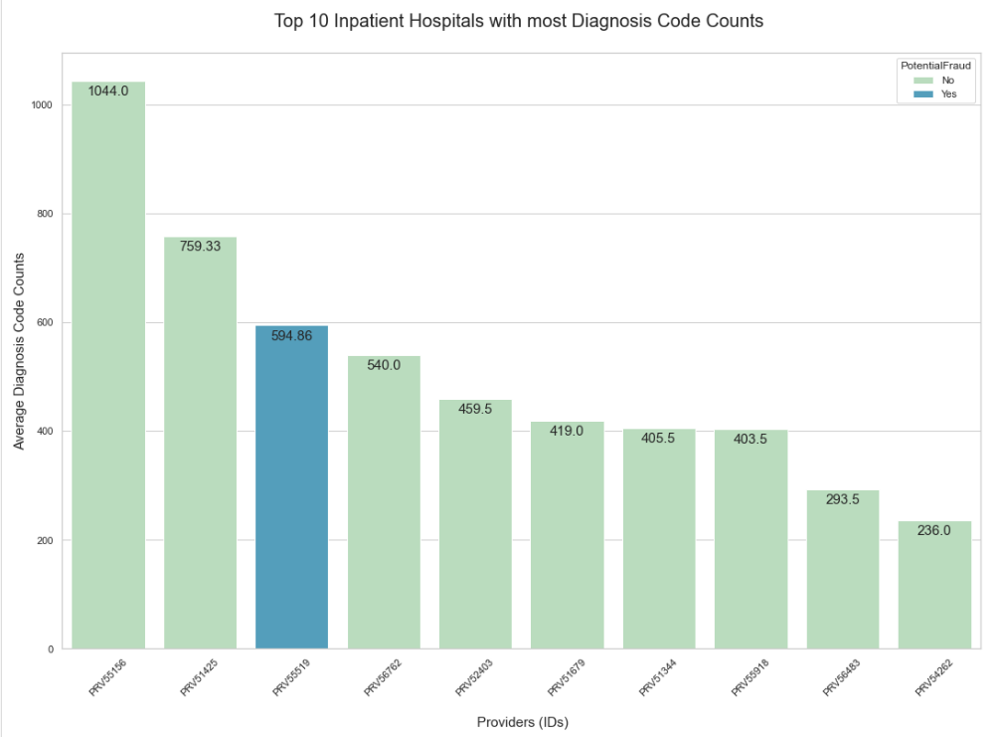
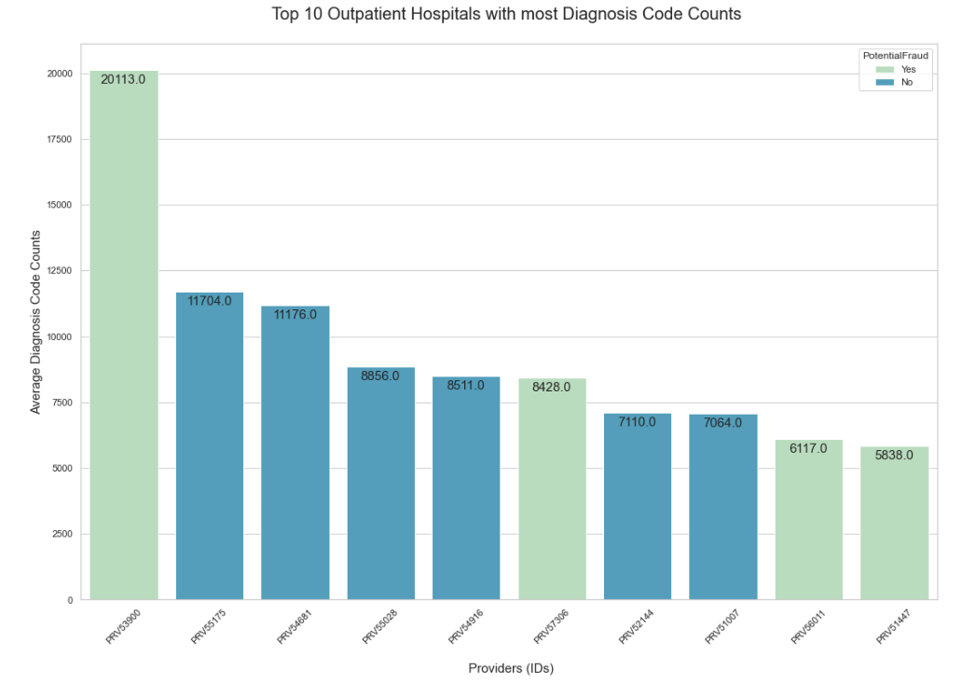
Fraud vs non-fraud provider study:

Slide 13
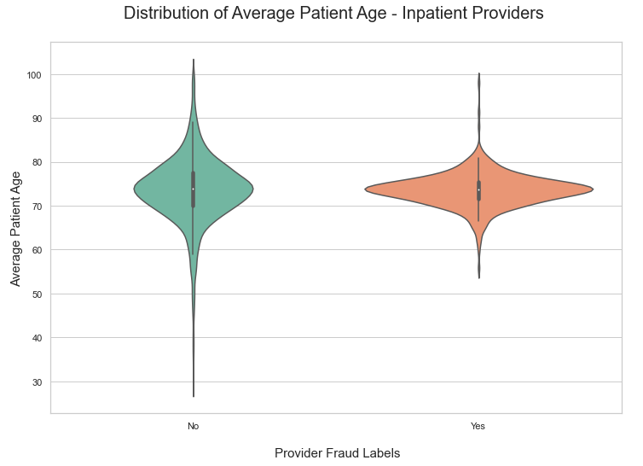
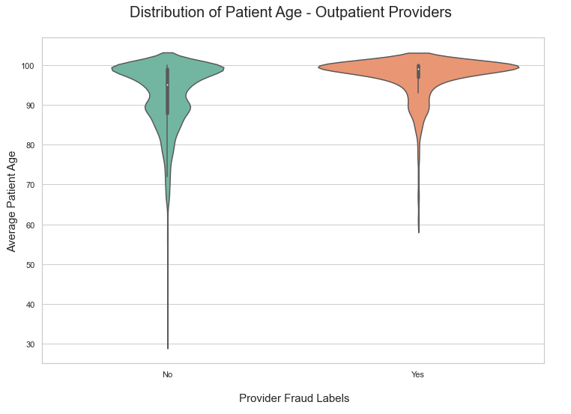
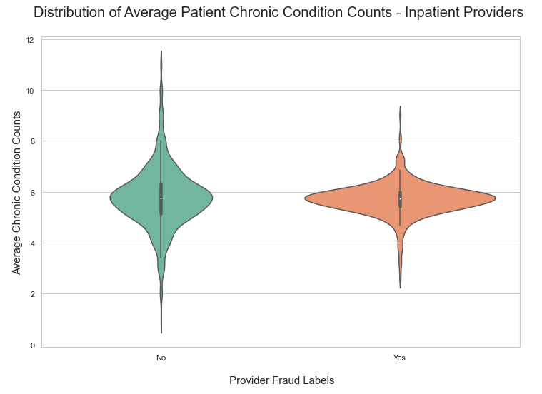
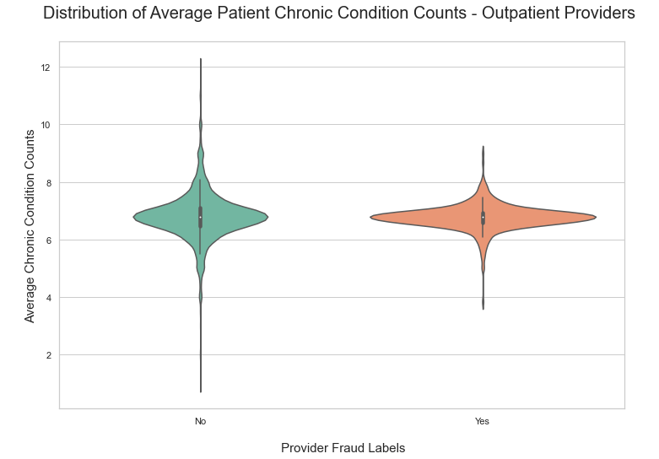
Fraud vs non-fraud provider study:

Slide 14
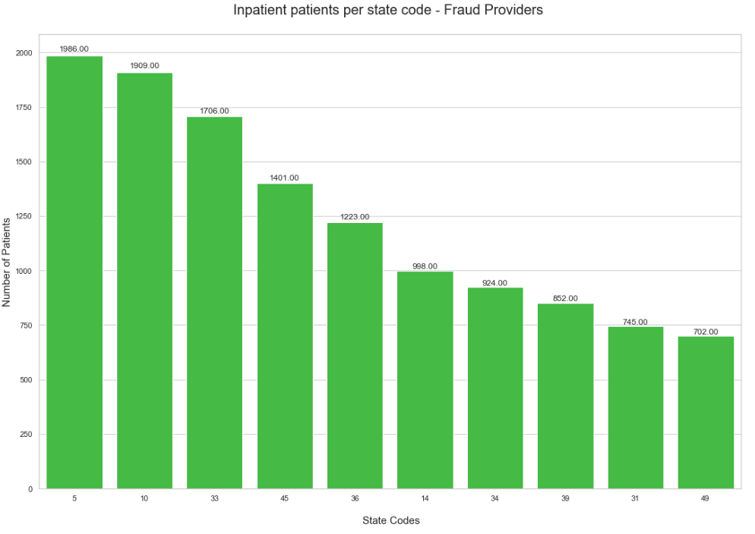
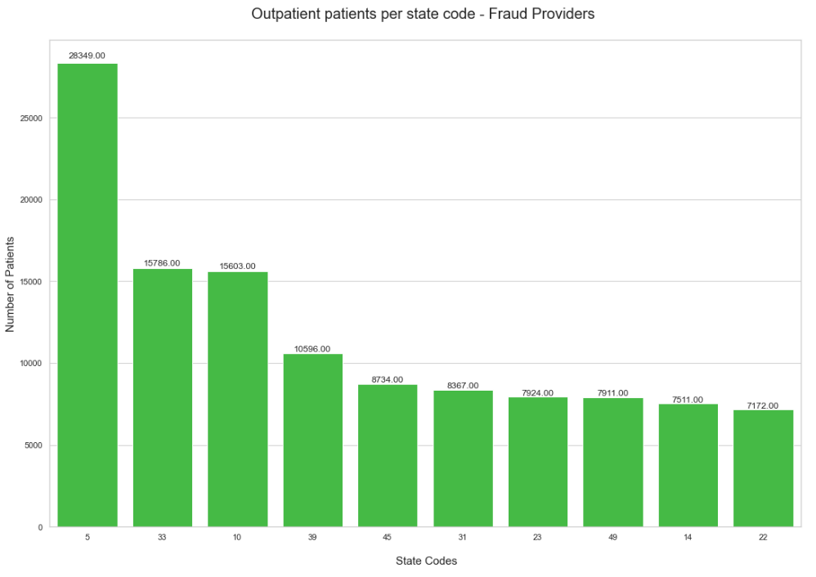
Fraud vs non-fraud provider study:

Slide 15
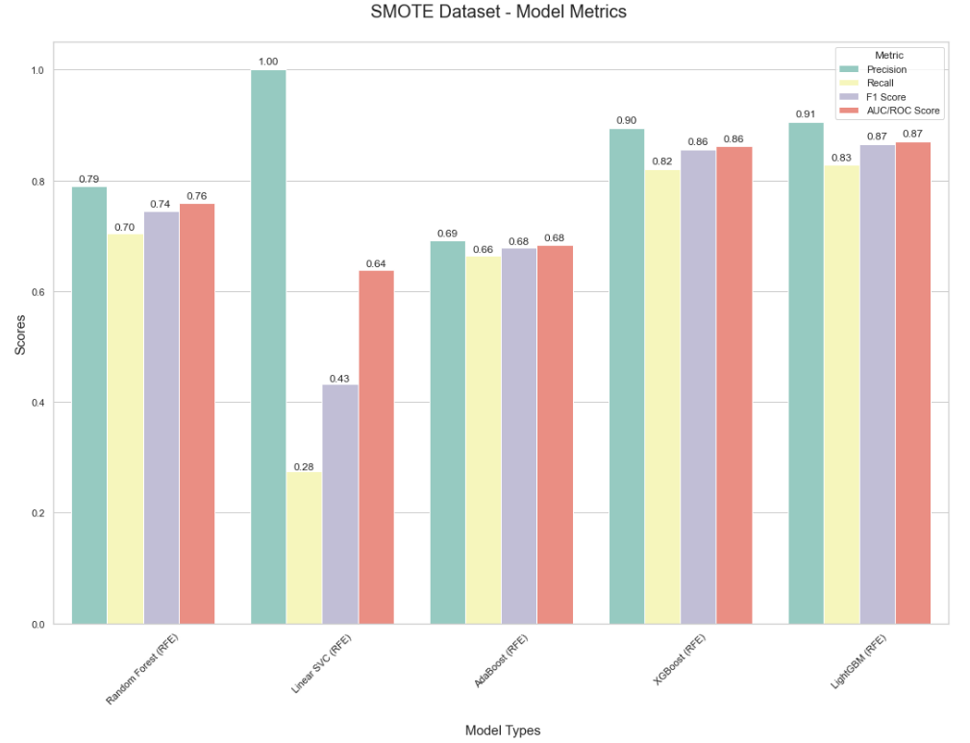
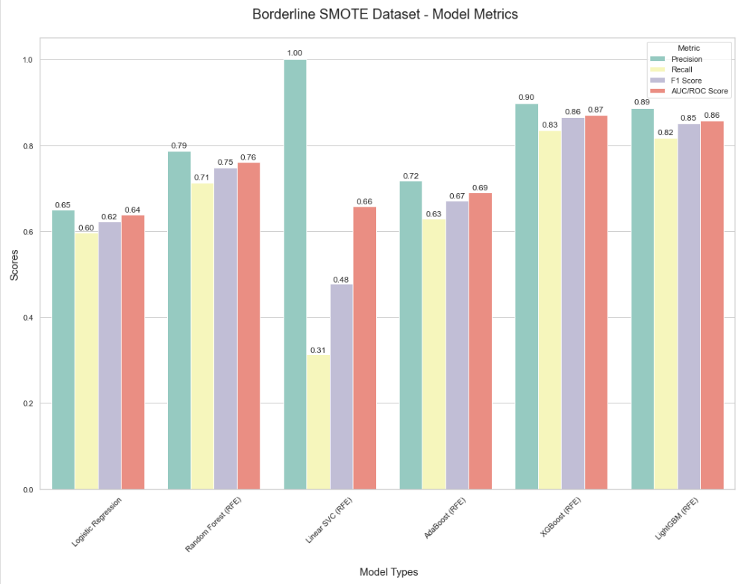
Data Modeling Results:

Slide 16
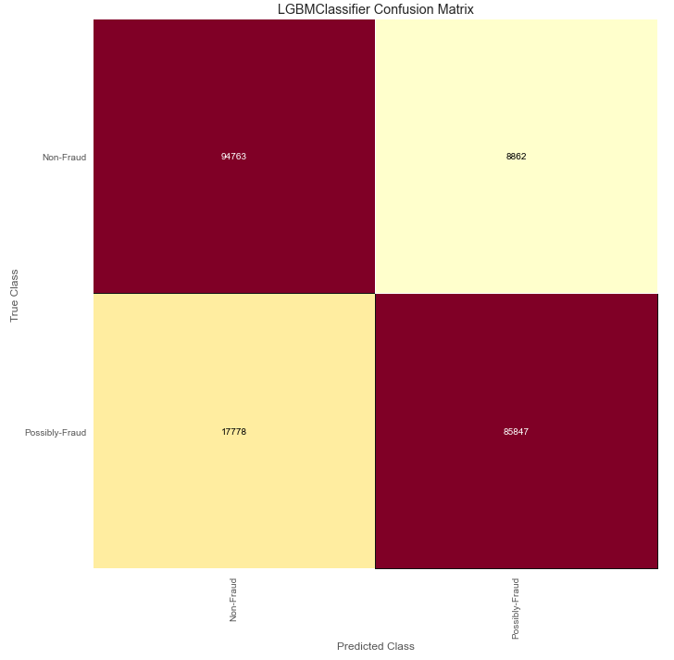
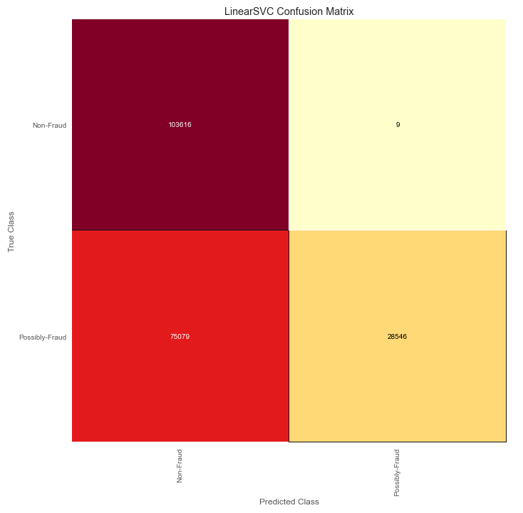
Lightgbm Model (smote data)

Slide 17
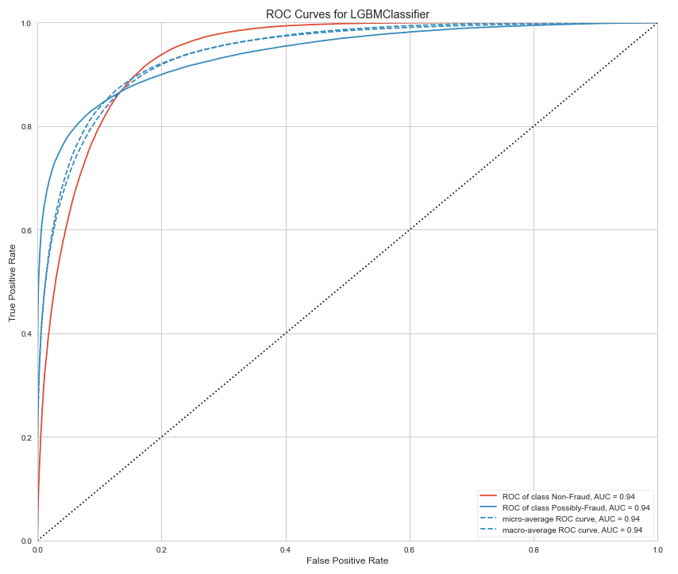
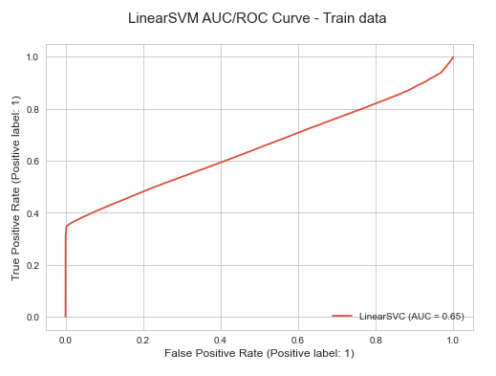
Lightgbm Model (smote data)

Slide 18
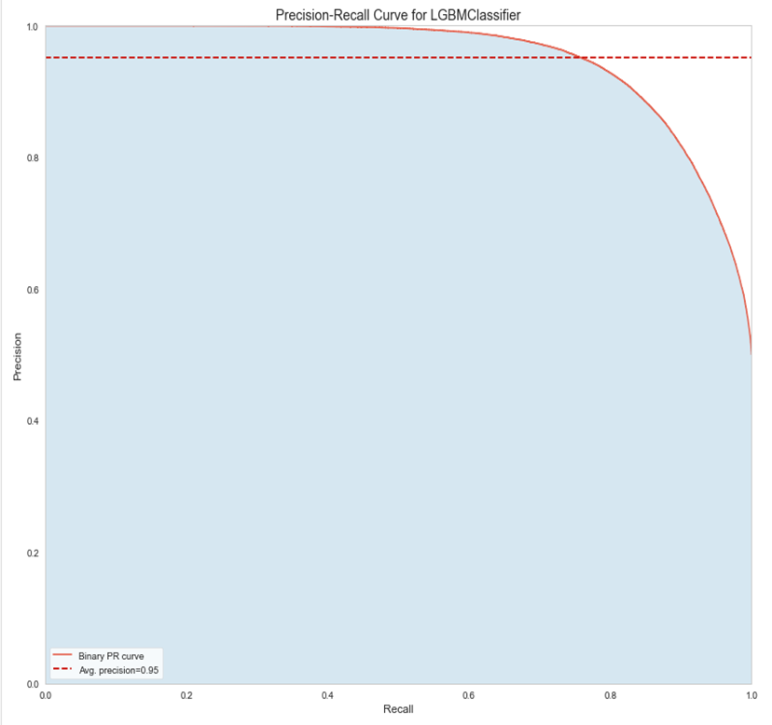
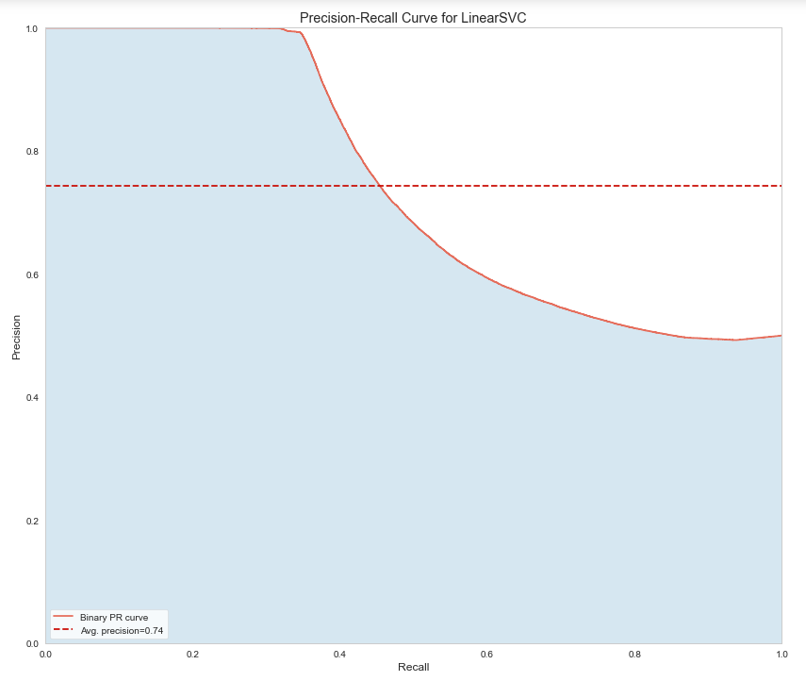
Lightgbm Model (smote data)

Slide 19
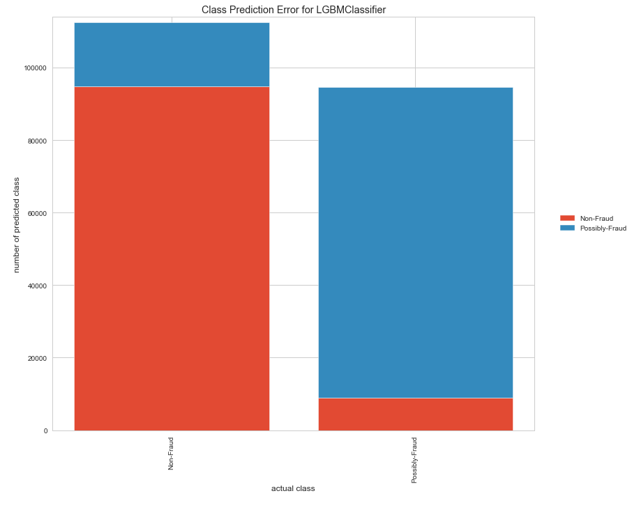
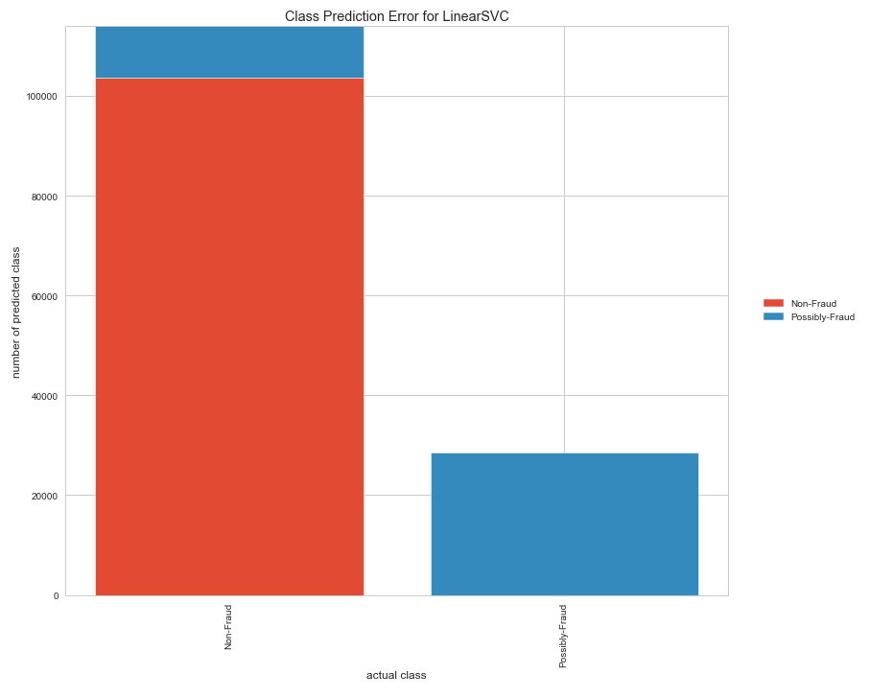
Lightgbm Model (smote data)

Slide 20
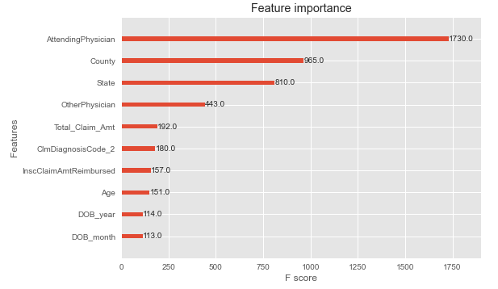
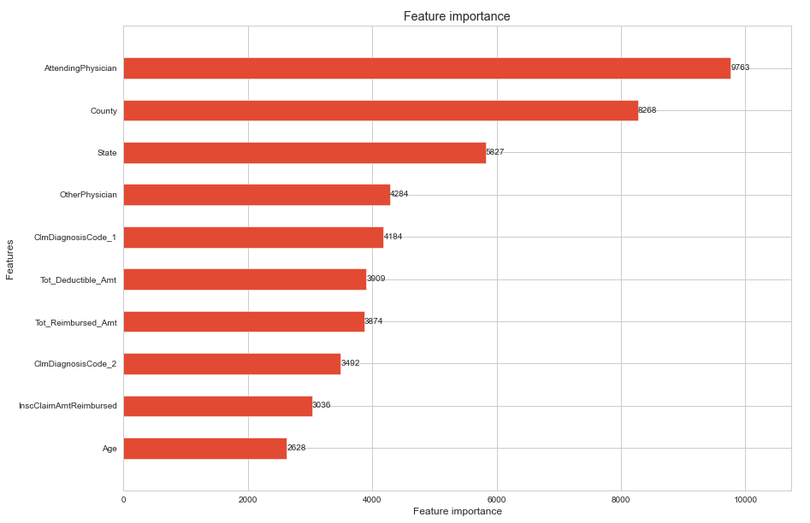
FEATURE IMPORTANCES:
XGBoost Model:
LightGBM Model:

Slide 21
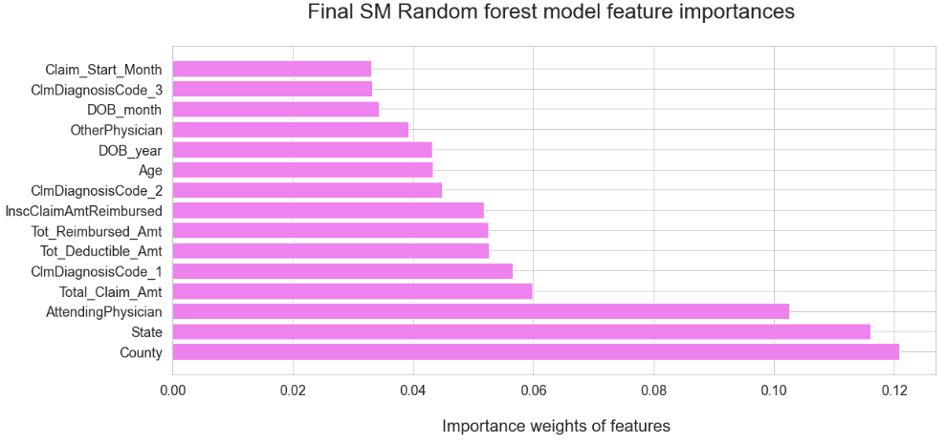
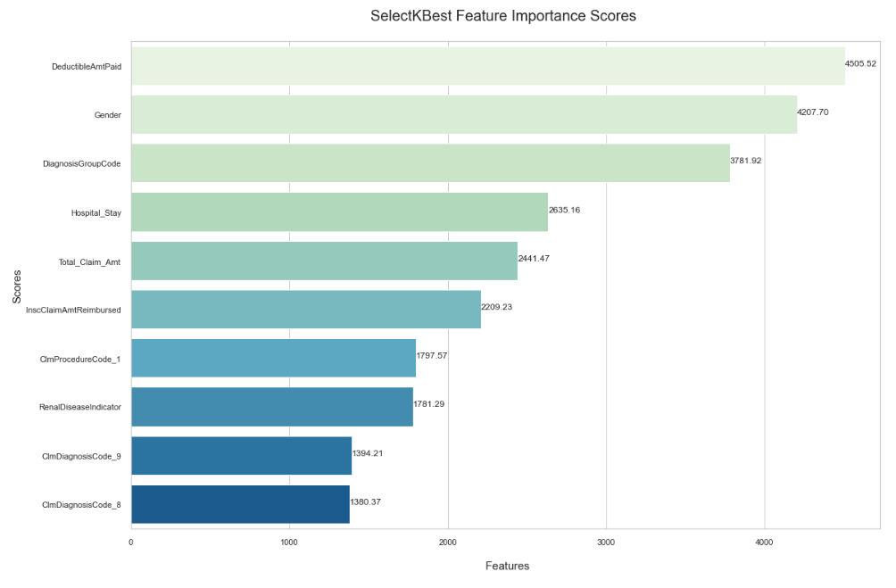
FEATURE IMPORTANCES:

Slide 22


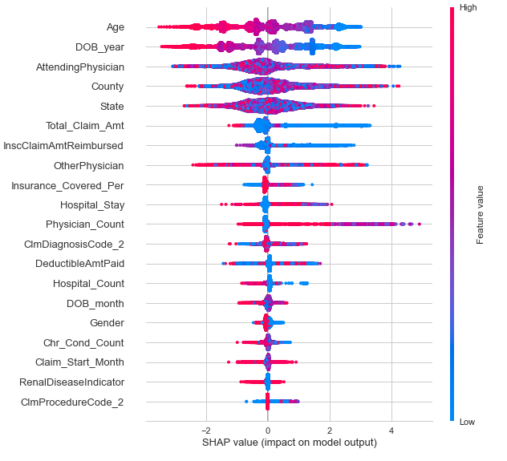
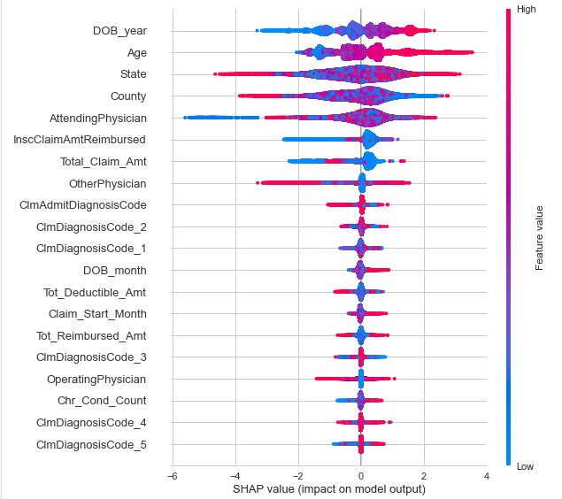
SHAP VALUE GRAPHS:

Slide 23
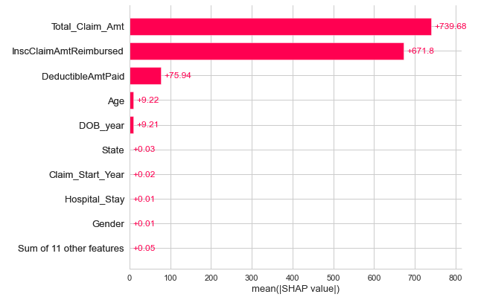
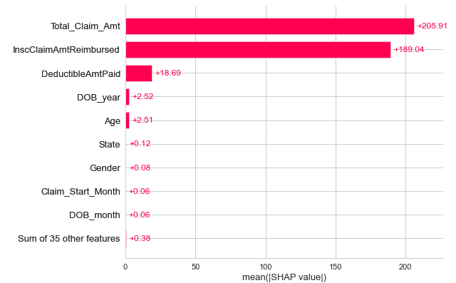
Linear model (shap values):
LinearSVM Model:
Logistic Regression Model:

Slide 24
CONCLUSIONS:
Certain Beneficiaries having high reimbursement amounts or paying high deductibles also have more chronic conditions and could be more susceptible to fraud.
Possibly Fraud providers could be more in certain states and counties.
A patient’s age being in a certain range, and who their primary doctor is could in certain cases make them more vulnerable to fraud.
Possibly Fraud Providers | Non-Fraud Providers
High average claim reimbursement amounts. Some of these providers have the highest reimbursement amounts in the dataset. | Low average claim reimbursement amounts
High average number of patient insurance claims. | Low average number of patient insurance claims.
A narrow range of patient age. | A wider range of patient age.
A narrow range of total patient chronic condition counts. | A wider range of total patient chronic condition counts.
Outpatient – high number of diagnosis codes listed on claims | Outpatient - low number of diagnosis codes listed on claims
Future work: Duplicate claim investigation, Doctor-Hospital Network analysis, studying patterns in beneficiaries, and conducting a market basket analysis.

Slide 25

Thank You!

